Slide 1

0. As Class Begins…
Orientation: How do we learn economics? Especially now with COVID-19?
Video: Introduction <https://github.com/braddelong/public-files/blob/master/video-module-0-intro-2020-05-14.mp4> <https://www.youtube.com/watch?v=AnSjX8ClAXQ>
Read: Prefatory notes on Matuschak & Dasgupta
Andy Matuschak: Why Books Don’t Work <https://github.com/braddelong/public-files/blob/master/readings/article-matuschak-books.pdf>
Partha Dasgupta: Economics: A Very Short Introduction <https://github.com/braddelong/public-files/blob/master/readings/book-dasgupta-economics.pdf>
Write:
Quiz: Check Your Comprehension: Dasgupta & Matuschak
Discuss: Reaction to Readings for: 0. As Class Begins…
Read, Listen, & Talk:
Slides with Audio:
Sokrates vs. Machiavelli on the educational process
Typical module activity flow
Dasgupta’s take on how to do economics
Logistics
Optional: A liberal education
Zoom Session: TBS (to be scheduled)
Apply:
Do: Introduction to Jupyter Notebooks
Discuss: Takeaways from & Extensions of: 0. As Class Begins…
Addenda:
Text for Lectures on: 0. As…
Learning Goals for: 0. As…
Optional Further Readings:
Link
Link
UNFINISHED; ??? of audio in this module

Slide 2
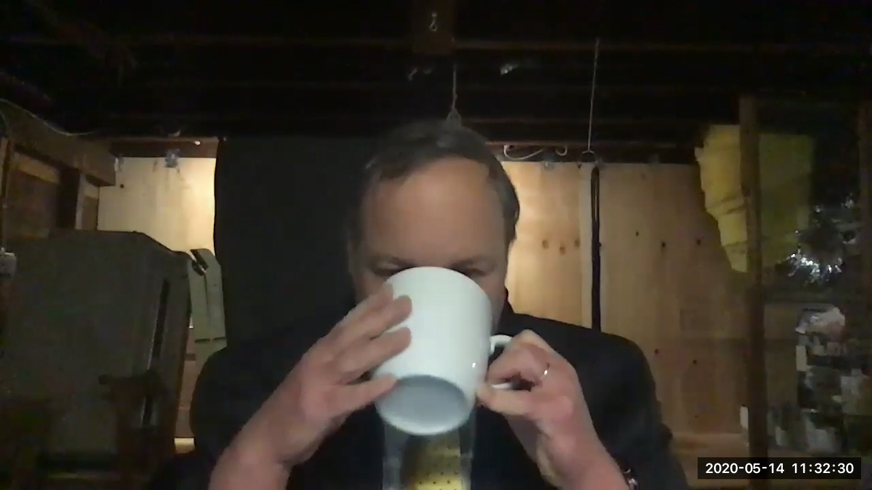
Video Introduction
Link
Orientation: How do we learn? Especially now, with COVID-19, when we are online? We need an answer to that question if we are not going to make a hash of this… <https://github.com/braddelong/public-files/blob/master/video-module-0-intro-2020-05-14.mp4> <https://www.youtube.com/watch?v=AnSjX8ClAXQ> <https://www.bradford-delong.com/2020/05/intro-how-do-we-learn-online-especially.html>
1:37 of video
Notes:
Welcome. I am Brad DeLong.
Videos are arresting. Videos are essential. But videos are also a pale shadow of and thus much more boring than in person presence.
It is, therefore, hard to maintain engagement without superb actors and an entire focused team of Hollywood professionals.
So let me be brief:
I am recording this from my basement in the spring of coronavirus, as American universities frantically pile online so that we can keep teaching. And as we do so we face an intellectual crisis.
The intellectual crisis is this:
Universities got their start, back when books were really expensive, as the only places you could read lots of books (in the library) and listen to lots of books being read aloud (in the lectures). But then came Johann Gutenberg, and books became really cheap. You could have your library, and read your books, almost anywhere.
Yet universities did not disappear.
Rather, over the past half millennium, they have flourished.
Why?
Unless and until we successfully answer that question, we are going to make a total hash of moving online. Here I take a stab at suggesting possible answers to this “why?” question.
And here I also ask and suggest some possible answers to the questions: what is economics? And: what is economics good for?
Once again: welcome. I very much hope you have fun here. I very much hope you learn stuff here.
——
<https://github.com/braddelong/public-files/blob/master/video-module-0-intro-2020-05-14.mp4>
<https://www.youtube.com/watch?v=AnSjX8ClAXQ>
Intro: How Do We Learn (Online Especially)?: Video <https://www.bradford-delong.com/2020/05/intro-how-do-we-learn-online-especially.html>

Slide 3
Video Introduction Text
Welcome. I am Brad DeLong.
Videos are arresting. Videos are essential. But videos are also a pale shadow of and thus much more boring than in person presence.
It is, therefore, hard to maintain engagement without superb actors and an entire focused team of Hollywood professionals.
So let me be brief:
I am recording this from my basement in the spring of coronavirus, as American universities frantically pile online so that we can keep teaching. And as we do so we face an intellectual crisis.
The intellectual crisis is this:
Universities got their start, back when books were really expensive, as the only places you could read lots of books (in the library) and listen to lots of books being read aloud (in the lectures). But then came Johann Gutenberg, and books became really cheap. You could have your library, and read your books, almost anywhere.
Yet universities did not disappear.
Rather, over the past half millennium, they have flourished.
Why?
Unless and until we successfully answer that question, we are going to make a total hash of moving online. Here I take a stab at suggesting possible answers to this “why?” question.
And here I also ask and suggest some possible answers to the questions: what is economics? And: what is economics good for?
Once again: welcome. I very much hope you have fun here. I very much hope you learn stuff here.
——
<https://github.com/braddelong/public-files/blob/master/video-module-0-intro-2020-05-14.mp4>
<https://www.youtube.com/watch?v=AnSjX8ClAXQ>
Intro: How Do We Learn (Online Especially)?: Video <https://www.bradford-delong.com/2020/05/intro-how-do-we-learn-online-especially.html>
234 words; 1:37 of video
Notes:
Welcome. I am Brad DeLong.
Videos are arresting. Videos are essential. But videos are also a pale shadow of and thus much more boring than in person presence.
It is, therefore, hard to maintain engagement without superb actors and an entire focused team of Hollywood professionals.
So let me be brief:
I am recording this from my basement in the spring of coronavirus, as American universities frantically pile online so that we can keep teaching. And as we do so we face an intellectual crisis.
The intellectual crisis is this:
Universities got their start, back when books were really expensive, as the only places you could read lots of books (in the library) and listen to lots of books being read aloud (in the lectures). But then came Johann Gutenberg, and books became really cheap. You could have your library, and read your books, almost anywhere.
Yet universities did not disappear.
Rather, over the past half millennium, they have flourished.
Why?
Unless and until we successfully answer that question, we are going to make a total hash of moving online. Here I take a stab at suggesting possible answers to this “why?” question.
And here I also ask and suggest some possible answers to the questions: what is economics? And: what is economics good for?
Once again: welcome. I very much hope you have fun here. I very much hope you learn stuff here.
——
<https://github.com/braddelong/public-files/blob/master/video-module-0-intro-2020-05-14.mp4>
<https://www.youtube.com/watch?v=AnSjX8ClAXQ>
Intro: How Do We Learn (Online Especially)?: Video <https://www.bradford-delong.com/2020/05/intro-how-do-we-learn-online-especially.html>

